Slide 1
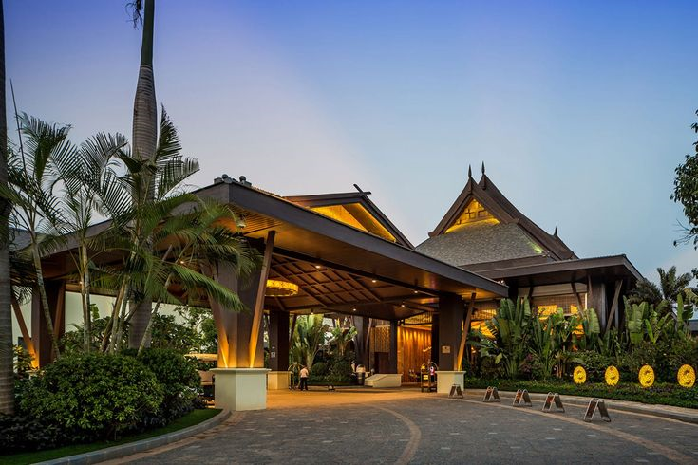
EDA-HOTEL BOOKING PROJECT
Presented by- Shraddha, Aditi, Sanika
Guided By –Abhishek wavhal

Slide 2
SUMMARY OF PROJECT
This Project was given to us by the Anudeep team with an intention to understand the Business done by Hotel Group.
This Dataset had two hotels City Hotel and Resort Hotel. The data provided was for 3 years 2015 , 2016 and 2017.We also have the revenue and booking details with number of days of stay and booking cancellation, total number of guests including children. It also specifies guests wait period for booking , reptation of guests, their food choices among others. The data also gives us an analyzation of countries from which bookings have been done. We also have a agent and other channels who also help in business by booking rooms for guests on the resort and city hotel behalf.
The data is divided between city hotel and resort hotel. so, we can make a fair comparison between both.
Before visualize any data from the data set We will do the data cleaning as to fill any null values and delete any duplicated values and after that we have to do data wrangling.
Also we will do our analysis for both city and resort as individual businesses and in comparison to one another. We will also take help of charts for better analysis.

Slide 3

PROBLEM STATEMENT
This data set contains booking information for a city hotel and a resort hotel
It includes information such as when the booking was made, the number of adults, children, and/or babies, and the number of available parking spaces, which agent made the booking, among other things.
The objective of this project is Explore and analyze the data to discover important factors that govern the bookings.

Slide 4



Slide 5
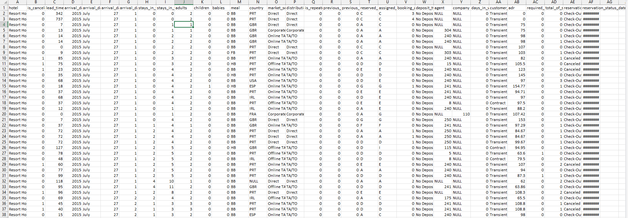
DATASET FIRST VIEW

Slide 6
Variable description
hotel – Type of hotel (Resort or City).
is_canceled – Booking status: 0 (not canceled) or 1 (canceled).
lead_time – Days between booking and arrival.
arrival_date_year – Year of arrival.
arrival_date_month – Month of arrival.
arrival_date_week_number – Arrival week number.
stays_in_weekend_nights – Weekend nights (Sat-Sun) stayed.
stays_in_week_nights – Weeknights (Mon-Fri) stayed.
adults – Number of adults.
children – Number of children.
babies – Number of babies.
meal – Meal type booked.
country – Guest's country.
market_segment – Booking category based on travel habits.
distribution_channel – Booking channel name.

Slide 7
Variable description
is_repeated_guest – 1 (repeat guest) or 0 (new guest).
previous_cancellations – Number of past canceled bookings.
previous_booking_not_canceled – Number of past successful bookings.
reserved_room_type – Reserved room type code.
assigned_room_type – Assigned room type code.
booking_changes – Number of changes made.
deposit_type – Type of deposit paid.
agent – Booking agent ID.
company – Company ID for corporate bookings.
days_in_waiting_list – Days booking was on the waitlist.
customer_type – Category of customer.
adr – Average Daily Rate (ADR).
required_car_parking_spaces – Parking spaces requested.
total_of_special_requests – Number of special requests.
reservation_status – Current reservation status.
reservation_status_date – Last update date for reservation.

Slide 8
WHAT DO WE KNOW ABOUT DATASET?
The given dataset is of Hotel Booking and we have to analyze and explore this dataset to discover important factors which affects the Hotel Booking. This dataset has 119390 rows and 32 columns.
The duplicate value count is 31994 rows.
There are 4 columns in dataset which is having missing values and those columns are company, agent, country and children.
There are separate columns called adults, children and babies that show the total number of people who are coming to visit, so instead of different columns will add these three in one called total_num_people

Slide 9
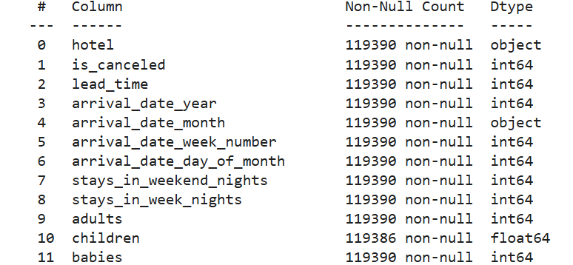
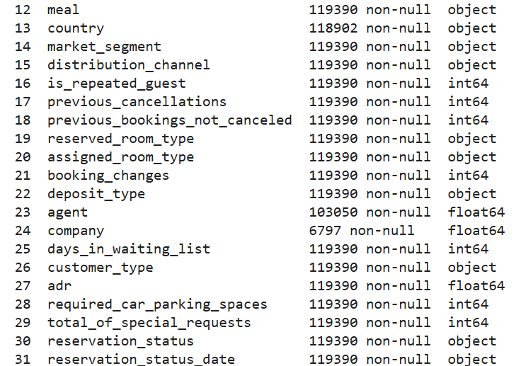
DATASET INFO

Slide 10
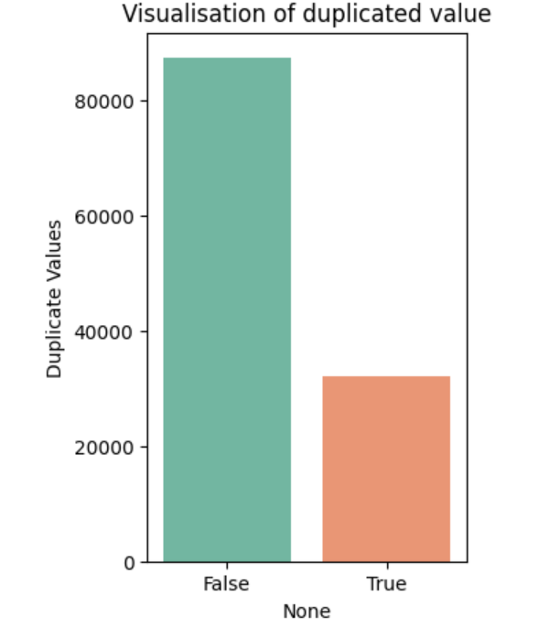
VISUALIZATION OF DUPLICATE VALUES
As part of the data cleaning process, we first checked the dataset for duplicate values.
We found that there were 31,994 duplicate records in the data.
These duplicates could have caused errors in the analysis, such as showing incorrect booking counts or misleading trends.
To avoid this, we removed all the duplicate entries. After cleaning, the dataset now has 87,396 unique records.

Slide 11
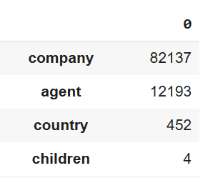
VISUALIZATION OF NULL VALUES
In the dataset, we found that four columns—Company, Agent, Country, and Children—had missing values. The missing values in each column were:
Company: 82,137 missing entries
Agent: 12,193 missing entries
Country: 452 missing entries
Children: 4 missing entries
To handle this, we replaced all missing values with NaN. This step makes the dataset cleaner and ensures that we can easily identify and manage missing data during analysis.

Slide 12
VISUALIZATION OF NULL VALUES
# Missing Values/Null Values Count
null values=df.isna()==True
null_values
df.fillna(np.nan , inplace=True)
df
#We have replaced all null values as NaN

Slide 13
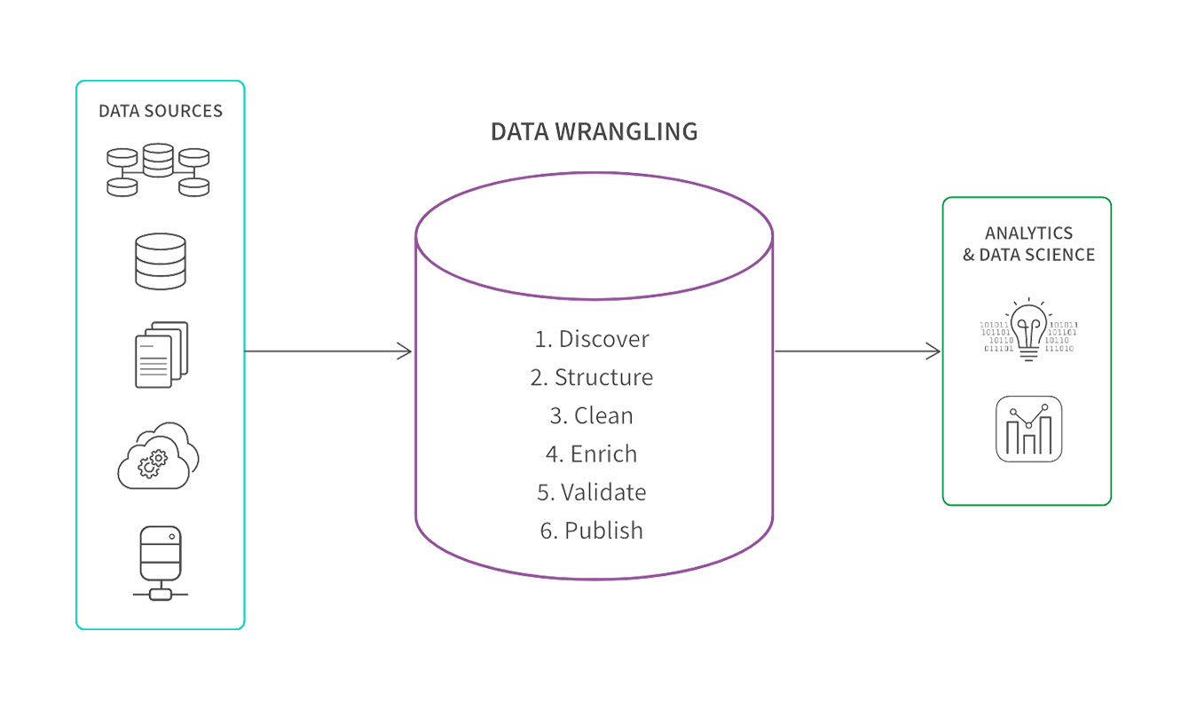
DATA WRANGLING
But we are Adding
Total stays in night .
Total No of guest( adults+ child+ babies).
We have created arrival date using columns [arrival_date_year, arrival_date_month, arrival_date_day _of_month ]
At the end we have given indexing.

Slide 14
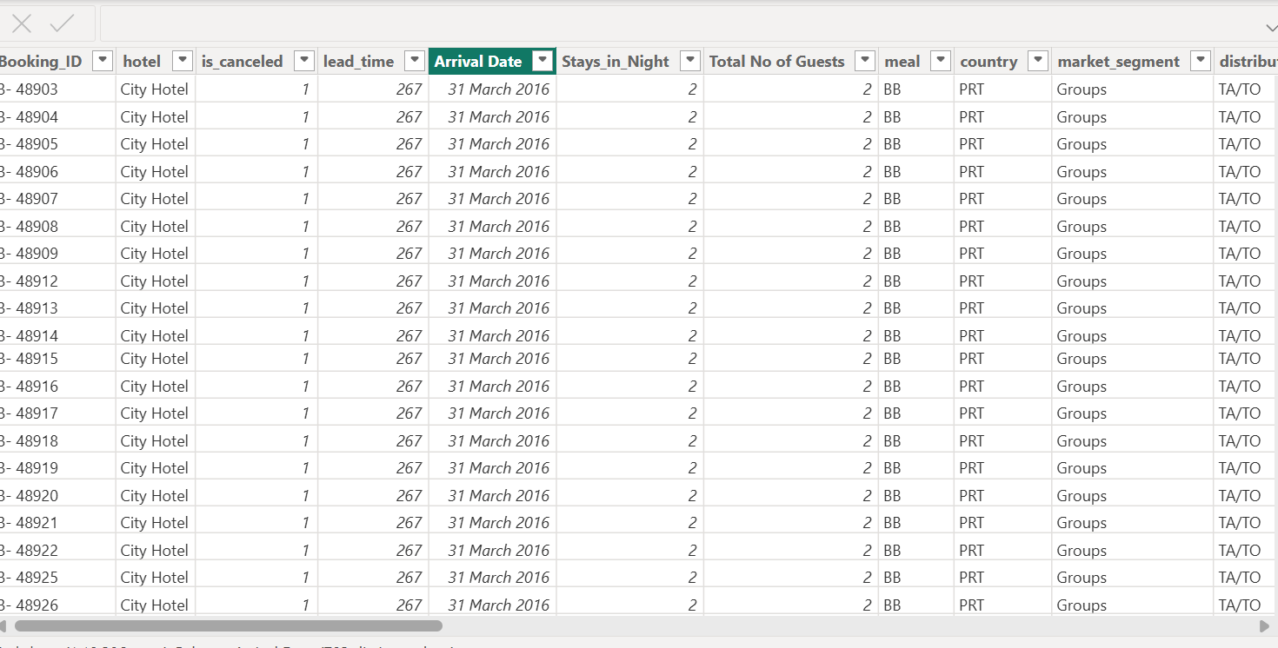
DATA WRANGLING

Slide 15
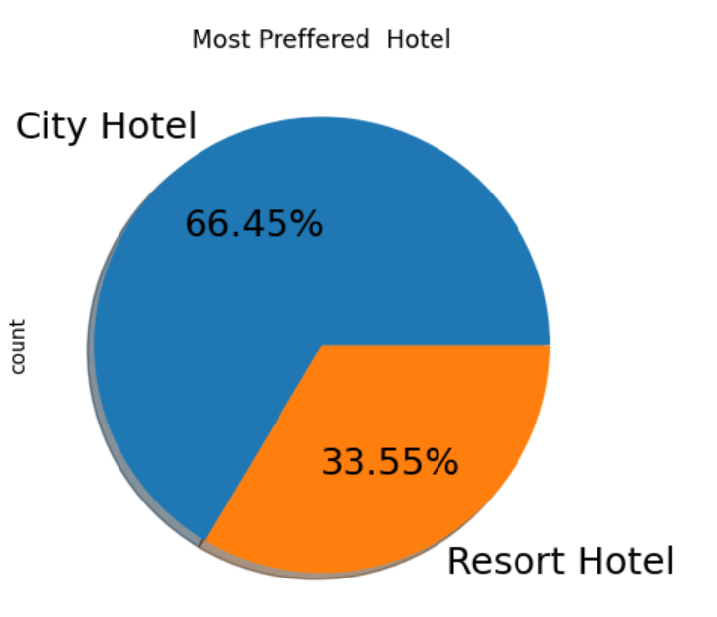
VISUALIZATION OF data
Which type of hotel have more number of bookings?
Based on the above observations, we found that 66.45% preferred city hotel and 33.55% preferred resort hotel for booking.
Which means Resort hotels have less booking.

Slide 16
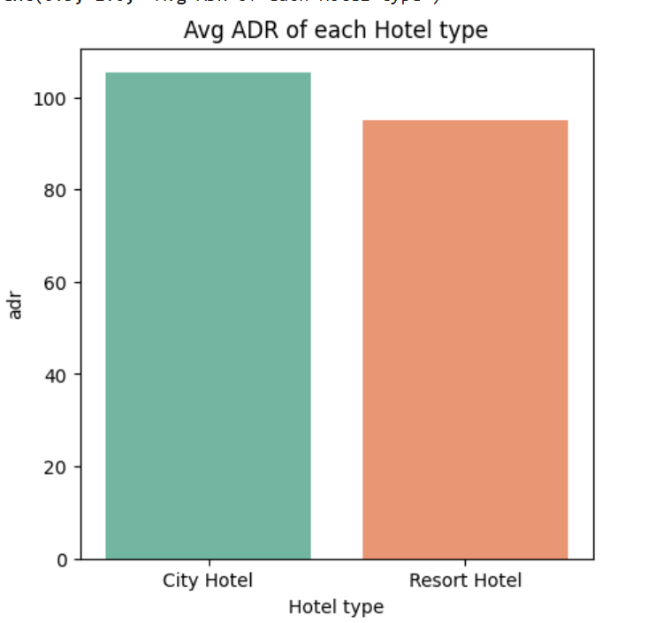
Which Type Of hotel have Highest revenue or ADR
City hotels generate higher revenue than resort hotels, as reflected by their higher Average Daily Rate (ADR).
With an ADR of 110, city hotels earn more per room compared to resort hotels, which have an ADR of 99.
This difference in ADR indicates that city hotels typically outperform resort hotels in terms of revenue generation

Slide 17
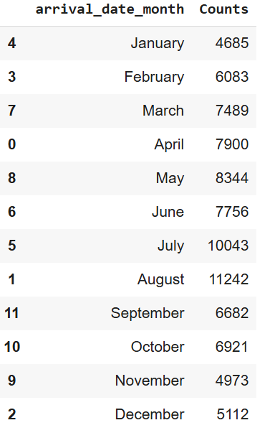
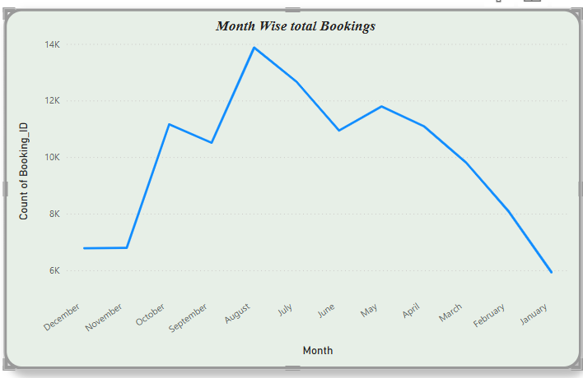
In which Month there are more number of bookings
July and August months had the most Bookings. Summer vacations can be the reason for the bookings
with increased volume of visitors will help hotel to manage revenue in this three months, will also help employee satisfaction and retention.

Slide 18
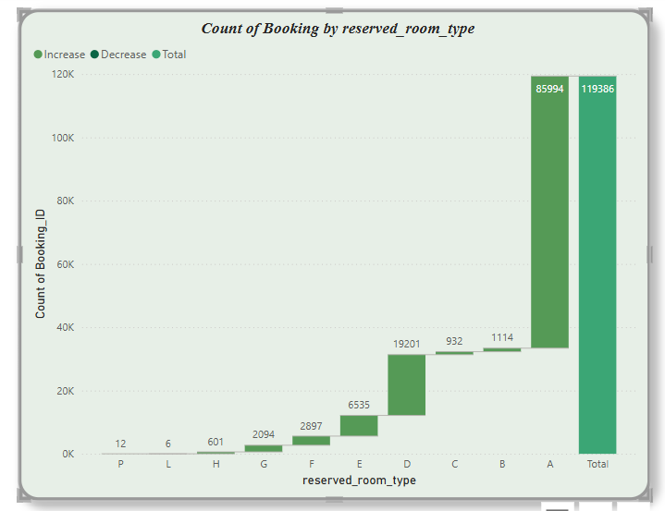
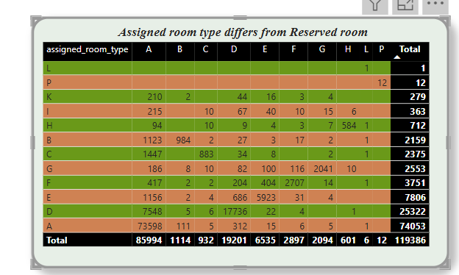
Which is the most preferred room type by guest
The management will be able to understand that the maximum bookings are done for type A and D hence they can either reduce type of rooms or get more amenities in other types. They can also give discounts.
Management should ensure that the room type booked by the customers is the one provided to them. If the management fails to do so, it may have an impact on their revenue

Slide 19
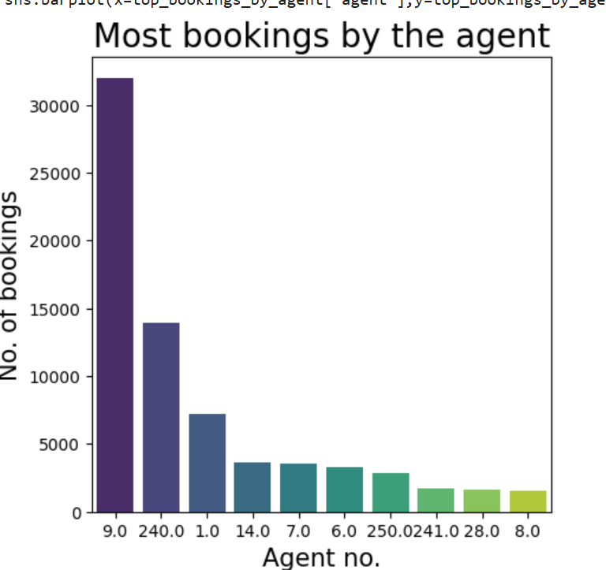
Which agent has made the most Booking
Agents 9 and 240 have made the highest number of bookings, which has a positive impact on the business by contributing significantly to revenue. In contrast, agents 28 and 8 have made the least number of bookings, which may indicate areas for improvement.
Focusing on the performance of these agents and addressing any challenges they face can help boost overall productivity and balance business growth.

Slide 20
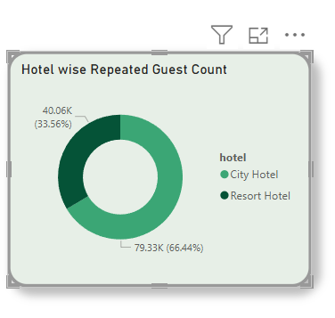
Which hotel has more repeated guest count
As we can see that count of repeated guest is more in city hotel as compared to resort hotel
This helps city hotel increase in revenue by gibing offers and discounts or memberships to repeated guest.
And also helps resort hotel to make strategy to attract the more people and increase the revenue

Slide 21
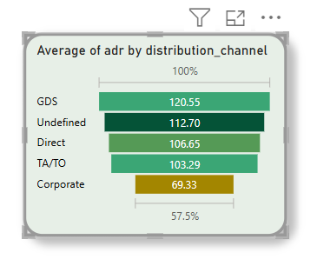
Revenue Generated by Distribution channel
This chart indicates the revenue generated through various distribution channels, revealing that the highest average revenue collection of 120.55 occurred through GDS.
The management should give attention on corporate channel to grow ADR

Slide 22
Solution to Business Objectives
Our analysis shows that city hotels are the most preferred, with the highest bookings and revenue recorded in 2016. Since most guests do not need parking, reducing investment in parking spaces can save costs. The busiest months for bookings are July and August, likely due to vacations and increased travel.
Most bookings are made through agents, and guests mainly come from Portugal, the United Kingdom, France, and Spain. Room categories A and D are the most popular, and many guests prefer to stay at the same hotel again. The BB-type meal is the most chosen food option.
As more guests book rooms, the Average Daily Rate (ADR) also increases, meaning higher occupancy leads to more revenue. To grow the business, hotels should focus on increasing bookings and attracting more long-term guests.
One key insight is the positive relationship between the number of bookings and the Average Daily Rate (ADR). As more guests book rooms, the revenue per room also increases, showing that higher occupancy leads to financial growth. To maximize profits, the hotel should focus on increasing guest stays and offering packages that encourage longer visits.
By improving marketing strategies, optimizing services based on guest needs, and enhancing customer satisfaction, the hotel can continue to grow and attract more visitors.

Slide 23
Result and conclusion
We found that 66.45% preferred city hotel and 33.55% preferred to book a resort hotel
The city hotel has made more number of bookings in years 2016 and 2017.The resort did have more bookings in 2016 but there was a noticeable decline in 2017.
The city hotels have more ADR that means City hotels Generate more Revenue than Resort Hotel
Here, we found that overall more than 27% of booking got cancelled
The month of July and August had the most Bookings. Summer vacation can be the reason for the bookings.
Agent no. 9 and 240 made highest bookings, where as least number of bookings are made by agent no 28 and 8
Room type A and D have been booked maximum in the last 3years.
From above insight we have found that the average stay length is 7 days for both types
**As the total number of people increases adr also increases. Thus, adr and total people are directly proportional to each other.**

Slide 24
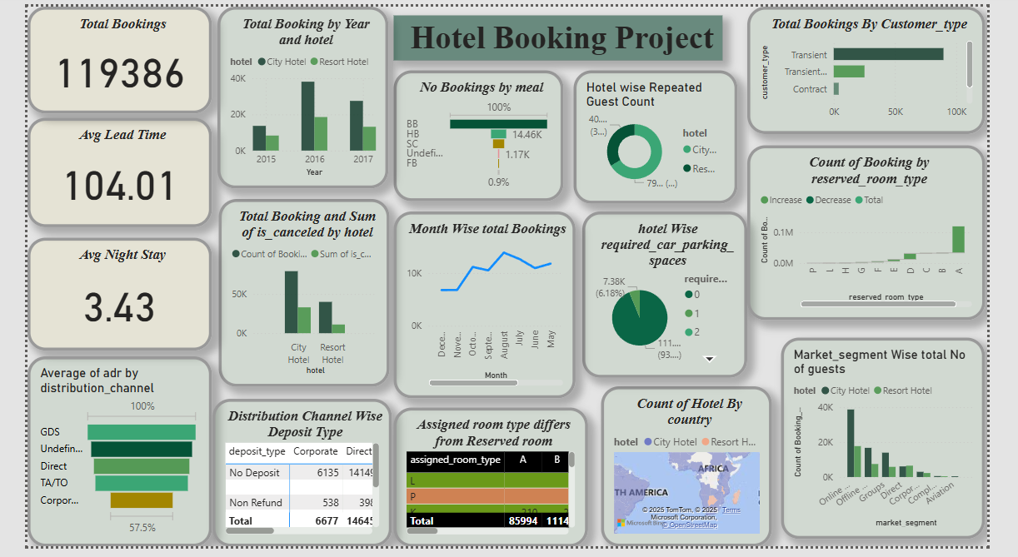

Slide 25

Thank you
Brita Tamm
502-555-0152
brita@firstupconsultants.com
www.firstupconsultants.com

Slide 26

Thank you
Brita Tamm
502-555-0152
brita@firstupconsultants.com
www.firstupconsultants.com

